Slide 1

Note
Flow control refers to a set of procedures used to restrict the amount of data that the sender can send before waiting for acknowledgment.
10.

Slide 2
Data link control.
Error control : is both error detection and correction. Error correction in data link layer is implemented simply: anytime an error is detected in exchange, specified frames are retransmitted. This process is called Automatic Repeat Request
10.

Slide 3
Note
Error control in the data link layer is based on automatic repeat request, which is the retransmission of data.
10.

Slide 4
PROTOCOLS
Now let us see how the data link layer can combine flow control , and error control to achieve the delivery of data from one node to another . The protocols are normally implemented in software by using one of the common programming languages.
Stop-and-Wait ARQ
Go-Back-N ARQ
Selective Repeat ARQ
PROTOCOLS

Slide 5
Stop-and-Wait ARQ
It is the simplest flow and error control mechanism . A transmitter sends a frame then stops and waits for an acknowledgment.
Stop-and-Wait ARQ has the following features:
The sending device keeps a copy of the sent frame transmitted until it receives an acknowledgment( ACK)
The sender starts a timer when it sends a frame. If an ACK is not received within an allocated time period, the sender resends it
Both frames and acknowledgment (ACK) are numbered alternately 0 and 1( two sequence number only)
This numbering allows for identification of frames in case of duplicate transmission

Slide 6
Stop-and-Wait ARQ
The acknowledgment number defines the number of next expected frame. (frame 0 received ACK 1 is sent)
A damage or lost frame treated by the same manner by the receiver
If the receiver detects an error in the received frame, or receives a frame out of order it simply discards the frame
The receiver send only positive ACK for frames received safe; it is silent about the frames damage or lost.
The sender has a control variable Sthat holds the number of most recently sent frame (0 or 1). The receiver has control variable R, that holds the number of the next frame expected (0,or 1)

Slide 7
Stop-and-Wait ARQ
Cases of Operations:
Normal operation
The frame is lost
The Acknowledgment (ACK) is lost
The Ack is delayed

Slide 8
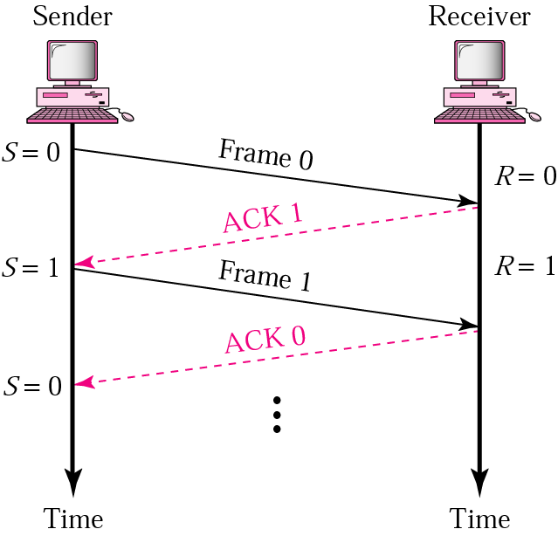
Stop-and-Wait ARQ
Normal operation
The sender will not send the next frame until it is sure that the current one is correctly receive
sequence number is necessary to check for duplicated frames

Slide 9
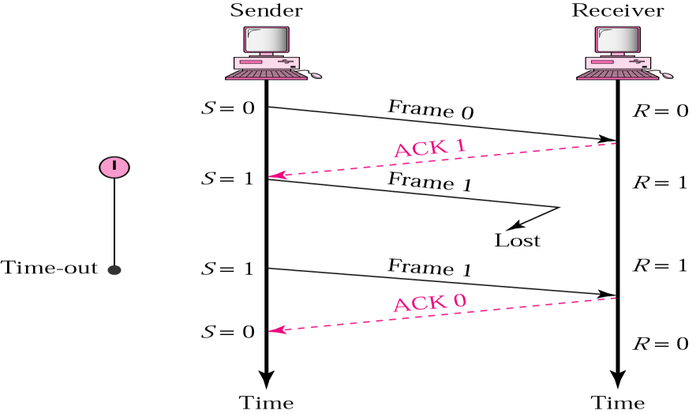
1. Stop and Wait ARQ
2. Lost or damaged frame
A damage or lost frame treated by the same manner by the receiver.
No NACK when frame is corrupted / duplicate

Slide 10
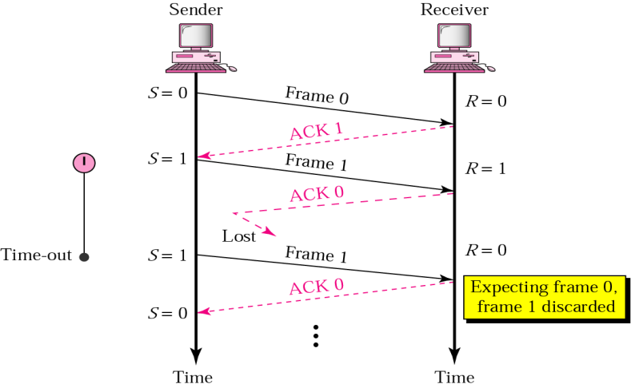
Stop-and-Wait ARQ
3. Lost ACK frame
Importance of frame numbering

Slide 11
Note
In Stop and-Wait ARQ, numbering frames prevents the retaining of duplicate frames.
10.

Slide 12
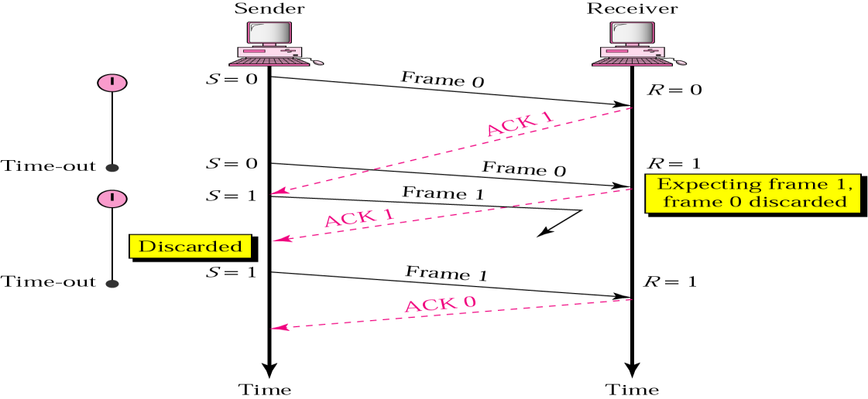
Stop-and-Wait ARQ
4. Delayed ACK and lost frame
Importance of frame numbering

Slide 13
Note
Numbered acknowledgments are needed if an acknowledgment is delayed and the next frame is lost.
10.

Slide 14
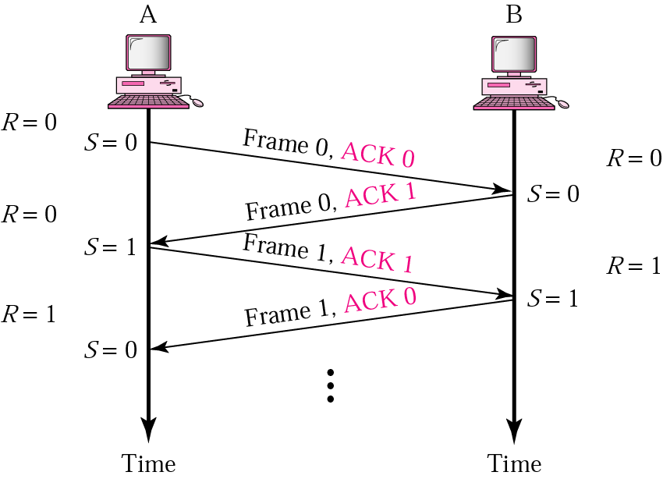
Piggybacking ( Bidirectional transmission)
Is a method to combine a data frame with an acknowledgment.
It can save bandwidth because data frame and an ACK frame can combined into just one frame

Slide 15
Stop-and-Wait ARQ
After each frame sent the host must wait for an ACK
inefficient use of bandwidth
To improve efficiency ACK should be sent after multiple frames
Alternatives: Sliding Window protocol
Go-back-N ARQ
Selective Repeat ARQ

Slide 16
Pipelining
Pipelining: A task is begun before the previous task has ended
There is no pipelining in stop and wait ARQ because we need to wait for a frame to reach the destination and be acknowledged before the next frame can be sent
Pipelining improves the efficiency of the transmission

Slide 17
Sliding window protocol
Sliding window protocols apply Pipelining :
Go-Back-N ARQ
Selective Repeat ARQ
Sliding window protocols improve the efficiency
multiple frames should be in transition while waiting for ACK. Let more than one frame to be outstanding.
Outstanding frames: frames sent but not acknowledged
We can send up to W frames and keep a copy of these frames(outstanding) until the ACKs arrive.
This procedures requires additional feature to be added :sliding window

Slide 18
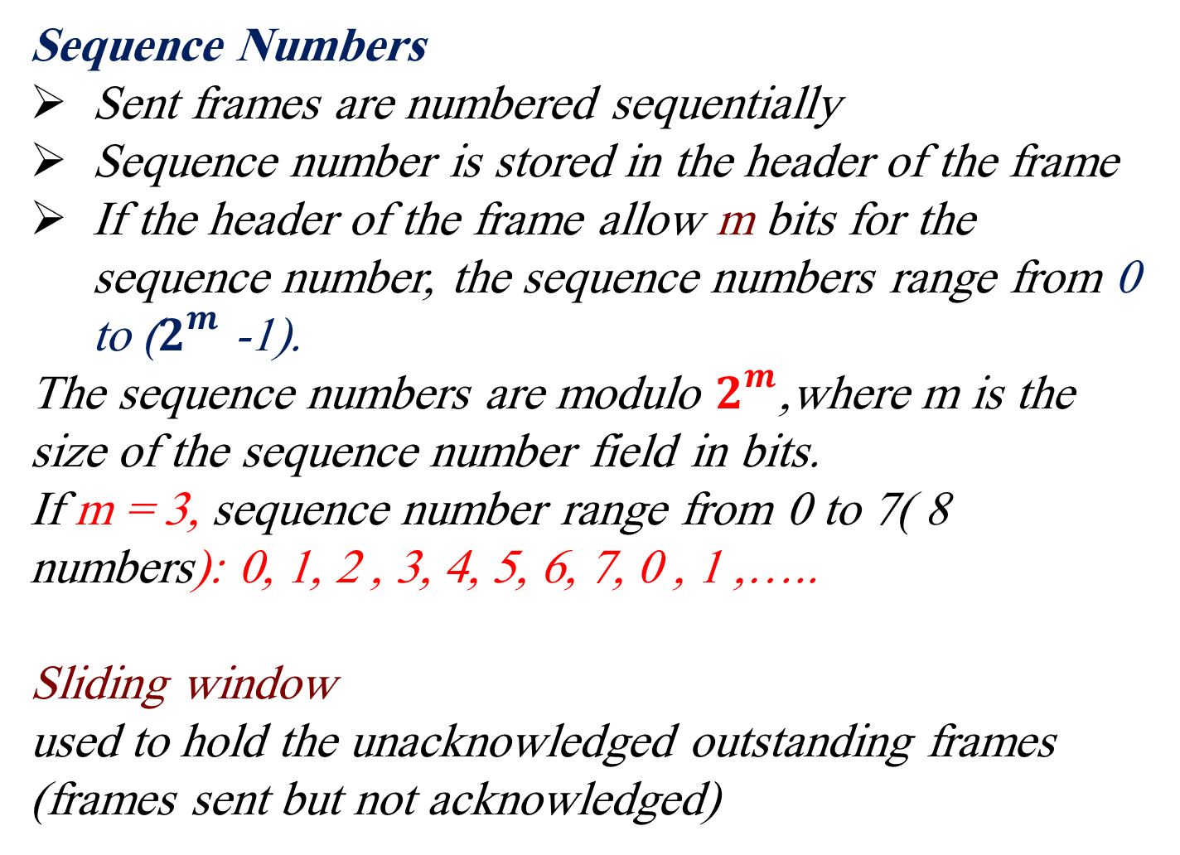
Sliding window

Slide 19
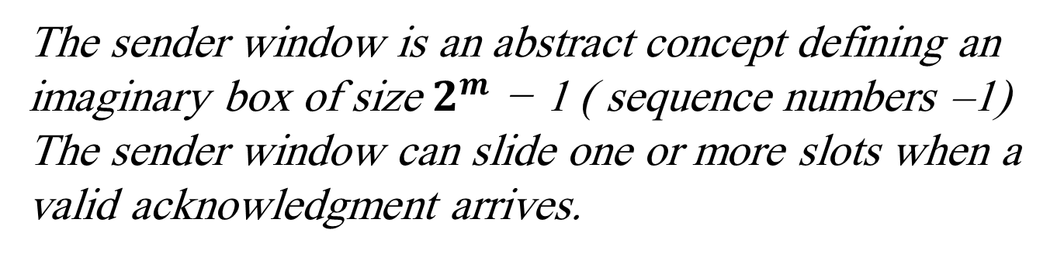
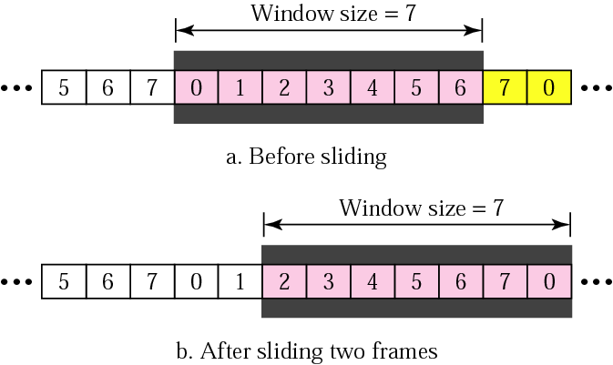
Go_Back _N ARQ
Sender sliding window
If m = 3; sequence numbers = 8 and window size =7
Acknowledged frames

Slide 20
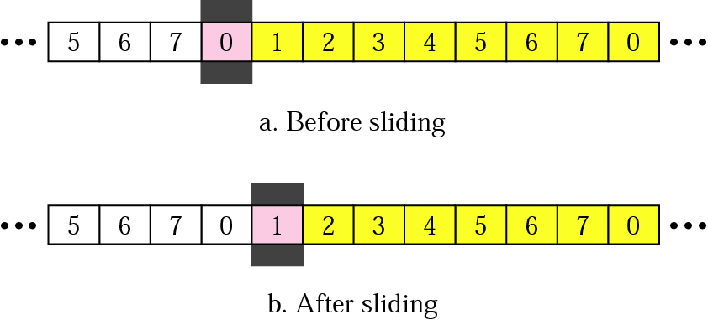
Go_Back _N ARQ
Receiver sliding window
The receive window is an abstract concept defining an imaginary box of size 1 with one single variable Rn.
The window slides when a correct frame has arrived; sliding occurs one slot at a time.

Slide 21
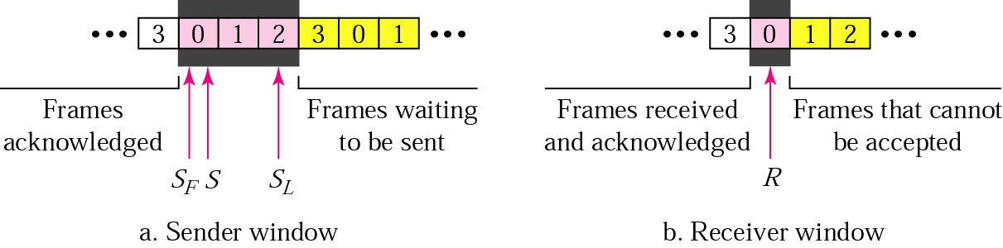
Go-Back-N ARQ
control variables
Outstanding frames: frames sent but not acknowledged
S: hold the sequence number of the recently sent frame
SF: holds sequence number of the first frame in the window
SL: holds the sequence number of the last frame
R: sequence number of the frame expected to received

Slide 22
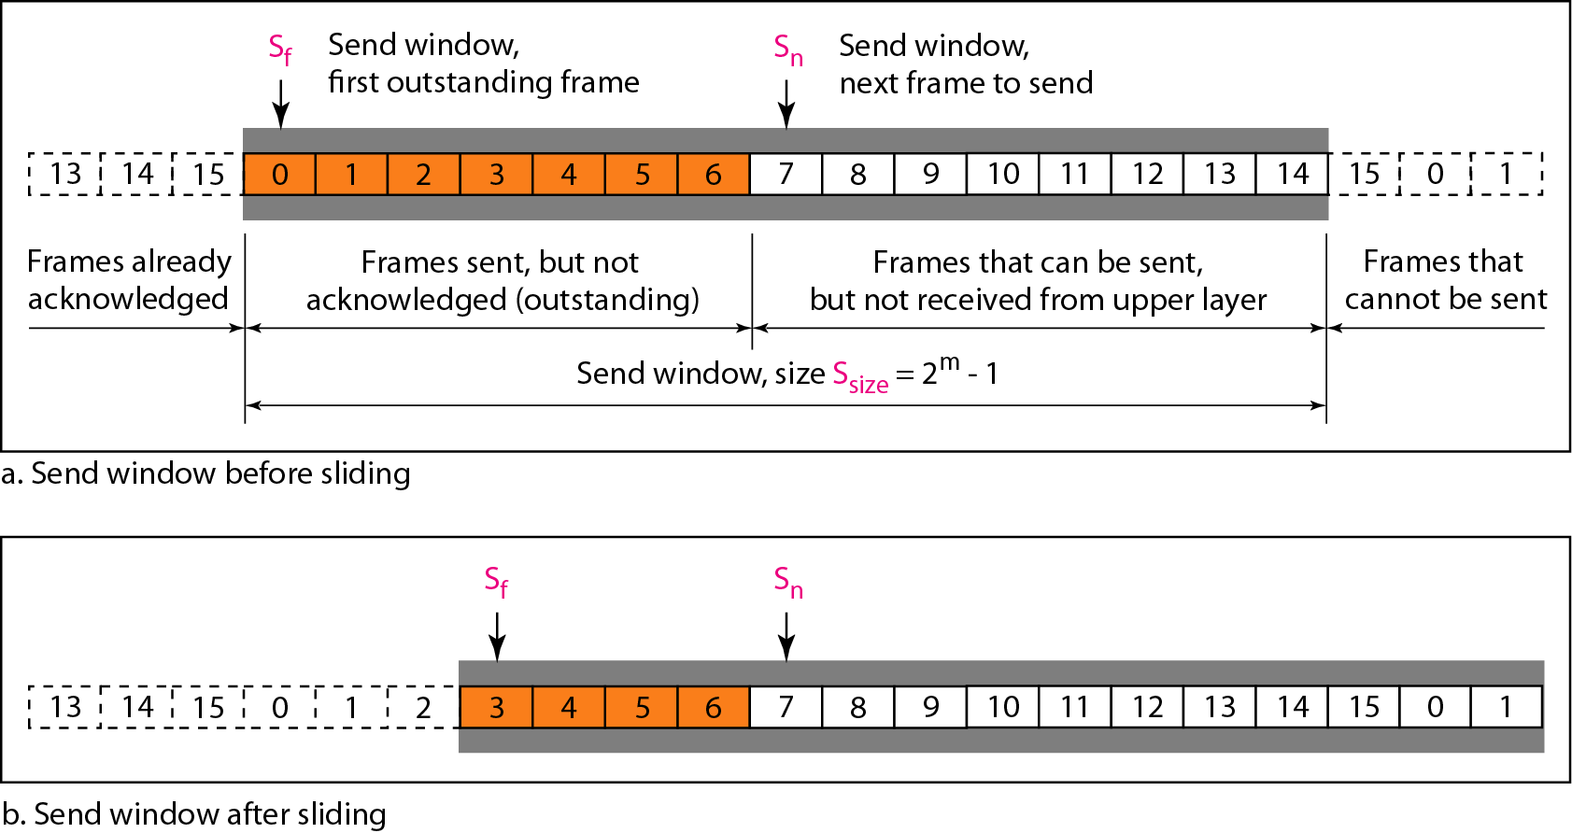
Go-Back-N ARQ

Slide 23
Go-Back-N ARQ
In Go-Back-N ARQ we use one timer for the first outstanding frame
The receiver sends a positive ACK if a frame has arrived safe and in order.
if a frame is damaged or out of order ,the receiver is silent and will discard all subsequent frames
When the timer of an unacknowledged frame at the sender site is expired , the sender goes back and resend all frames , beginning with the one with expired timer.( that is why the protocol is called Go-Back-N ARQ)
The receiver doesn't have to acknowledge each frame received . It can send cumulative Ack for several frame

Slide 24
Go-Back-N ARQ
Example: The sender has sent frame 6 , and timer expires for frame 3( frame 3 has not been acknowledge); the sender goes back and resends frames 3, 4,5 and 6

Slide 25
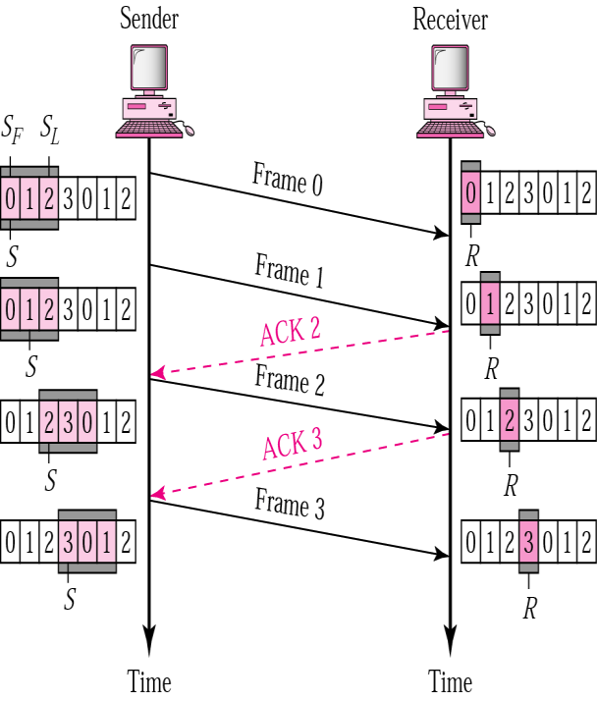
Go-Back-N ARQ
Normal operation
How many frame scan be transmitted Without acknowledgment?
ACK1 is not necessary if ACK2 is sent: Cumulative ACK

Slide 26
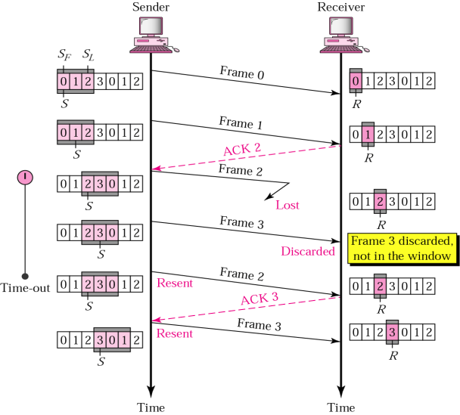
Go-Back-N ARQ
Damage or Lost Frame
Correctly received out of order packets are not Buffered
What is the disadvantage of this?

Slide 27
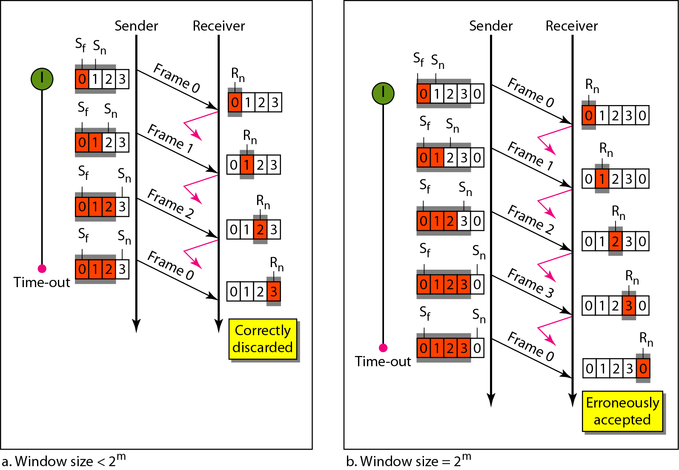
Go-Back-N ARQ

Slide 28
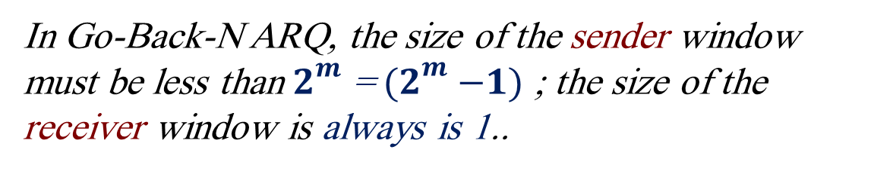
Go-Back-N ARQ
Bidirectional transmission : piggybacking
As Stop-and-Wait we can use piggybacking to improve the efficiency of bidirectional transmission . Each direction needs both a sender window and a receiver window.

Slide 29
Note
Stop-and-Wait ARQ is a special case of Go-Back-N ARQ in which the size of the send window is 1
10.

Slide 30
Selective Repeat ARQ
Go-Back-N ARQ is inefficient of a noisy link.
In a noisy link frames have higher probability of damage , which means the resending of multiple frames.
this resending consumes the bandwidth and slow down the transmission .
Solution:
Selective Repeat ARQ protocol : resent only the damage frame
It defines a negative Acknolgment (NAK) that report the sequence number of a damaged frame before the timer expires
It is more efficient for noisy link, but the processing at the receiver is more complex

Slide 31
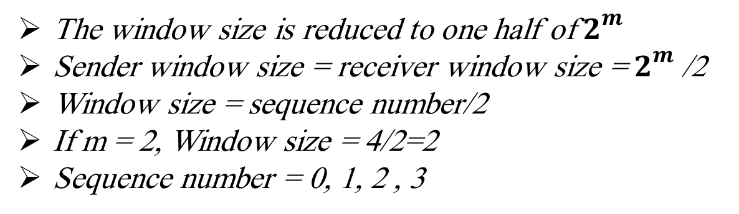
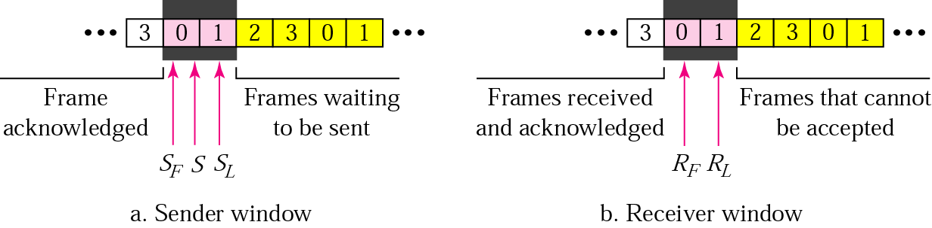
Selective Repeat ARQ

Slide 32
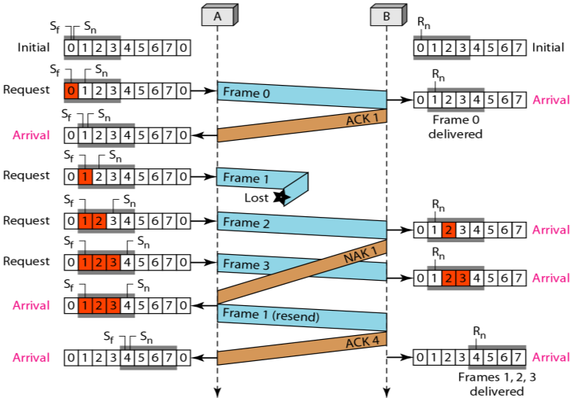
Selective Repeat ARQ
Lost Frame
m=3
Sequences no=2m =8 : 0,1,2 ,3,4,5,6,7Window size =2m/2= 8/2=4

Slide 33
Selective Repeat ARQ
At the receiver site we need to distinguish between the acceptance of a frame and its delivery to the network layer . At the second arrival , frame 2 arrives and is stored and marked , but it can not be delivered because frame 1 is missing . At the next arrival , frame 3 arrives and is marked and stored , but still none of the frames can be delivered . Only at the last arrival , when finally a copy of frame 1 arrives , can frames 1 , 2 , and 3 be delivered to the network layer. There are two conditions for the delivery of frames to the network layer: First , a set of consecutive frames must have arrived. Second, the set starts from the beginning of the window .

Slide 34
Selective Repeat ARQ
The next point is about the ACKs . Notice that only two ACKs are sent here. The first one acknowledges only the first frame; the second one acknowledges three frames. In Selective Repeat, ACKs are sent when data are delivered to the network layer. If the data belonging to n frames are delivered in one shot , only one ACK is sent for all of them.

Slide 35
Note
In Selective Repeat ARQ, the size of In the sender and receiver window must be at most one-half of 2m.
10.

Slide 36
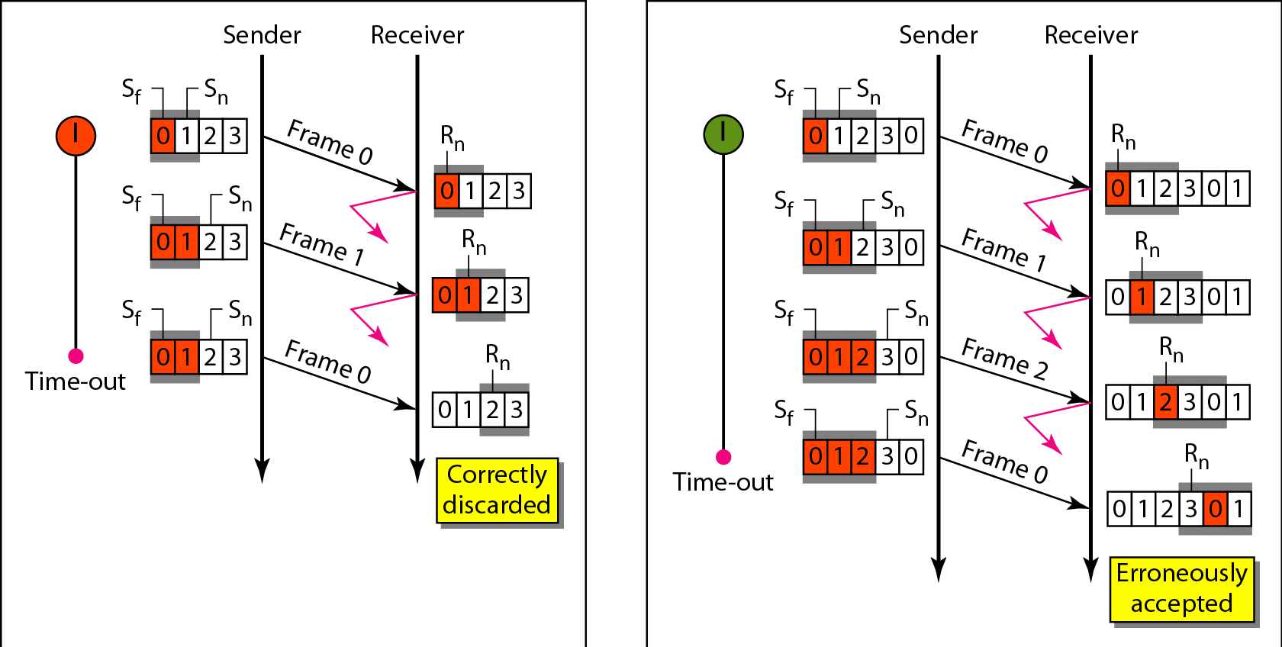
Selective Repeat ARQ
m=2

Slide 37
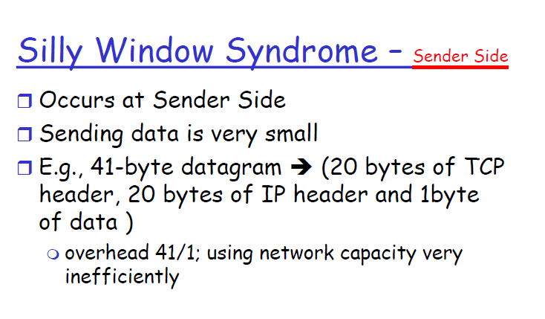
37

Slide 38
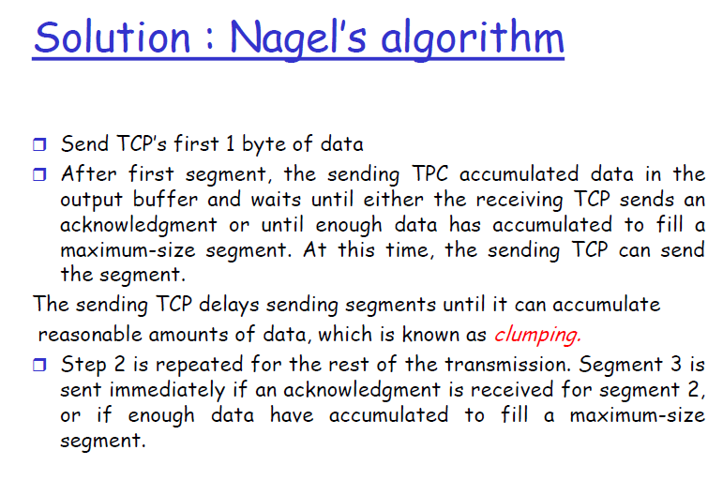
38

Slide 39

❒ If the application program is faster than the network the
segments are larger(maximum size segment).
❒ If the application program is slower than the network the
segments are smaller(less than the maximum size segment
size).
96

Slide 40
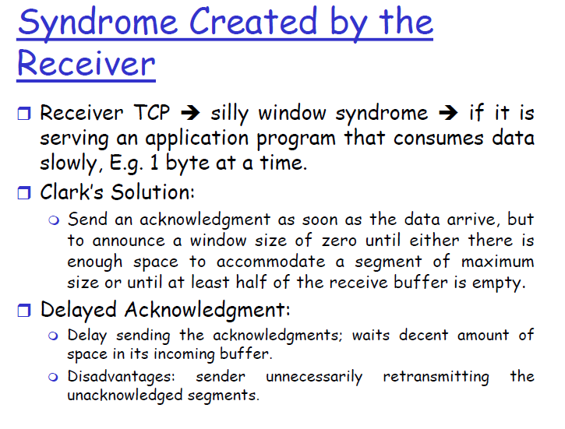
40

